Slide 1



VD25-816821
Sense Vision AI
Accessible Learning Tool
Next Slide
Artificial Intelligence (AI) is no longer just assistive technology—it’s a transformative force empowering visually impaired learners with accessibility, independence, and equal opportunities in education.
WHERE INNOVATION MEETS OPPORTUNITY.

Slide 2
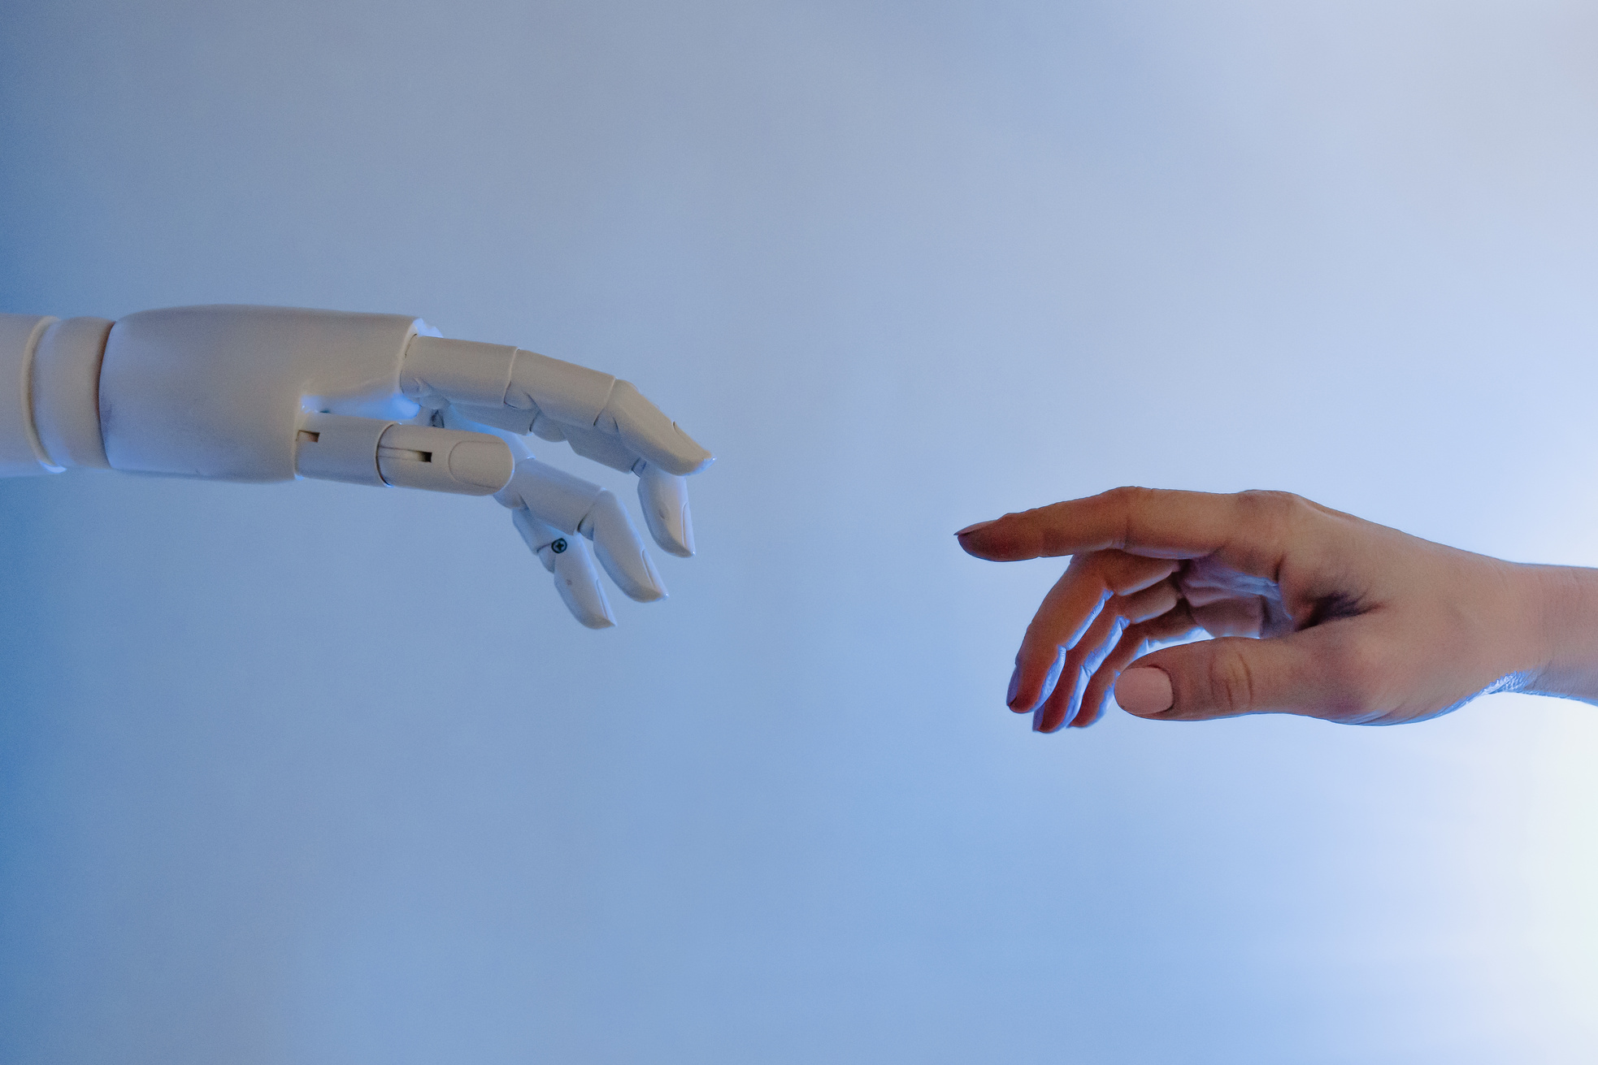

VD25-816821
Problem Statement
Challenges faced by visually impaired learners.
Lack of accessible, affordable, intelligent tools.

Slide 3
VD25-816821
Challenges:
Lack of accessible, affordable, intelligent learning tools for visually impaired..
Solution
VOICE-FIRST, CAMERA-ENABLED, MULTILINGUAL AI ASSISTANT.
OCR + TTS FOR DOCUMENTS.
IMAGECAPTIONINGFOR DIAGRAMS/GRAPHS/MAPS.
EMOTION-AWARE SPEECH + VOICE COMMANDS.

Slide 4
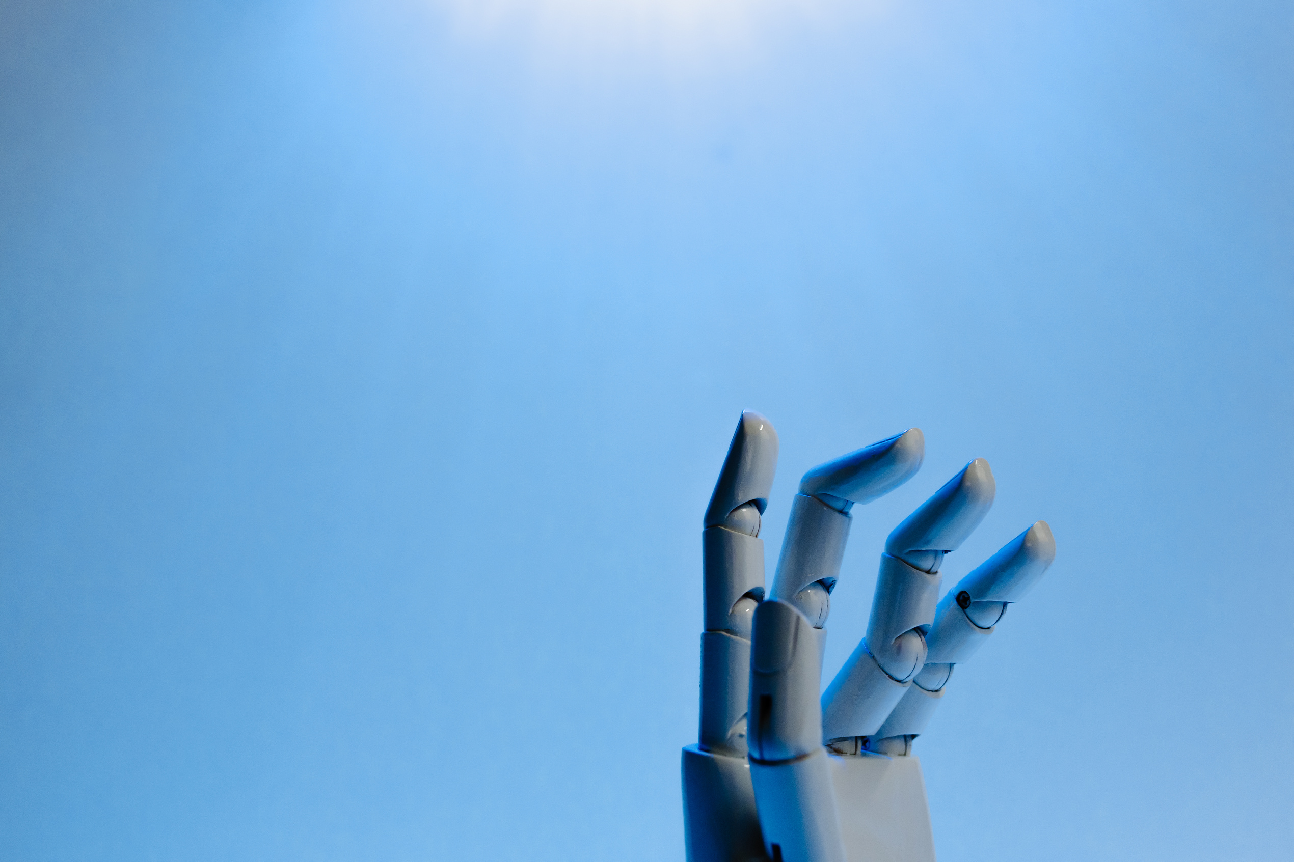
VD25-816821
Unique Value Proposition (UVP)
Multilingual support (English, Hindi, Telugu).
Automatic camera detection + hands-free use.
Accessibility-first design (WCAG standards).
Affordable, scalable for schools, NGOs, libraries.
Empowers independent learning for visually impaired students.
Next Slide

Slide 5

VD25-81682
CONTENT
Technical Approach
Frontend: React/Next.js (WCAG accessibility).
Backend: Node.js + Express.
OCR: Google Vision OCR.
TTS: Google Cloud TTS.
AI Reasoning: Google Gemini
Image Captioning: BLIP.
Camera/Gesture: Media Pipe.
Next Slide

Slide 6
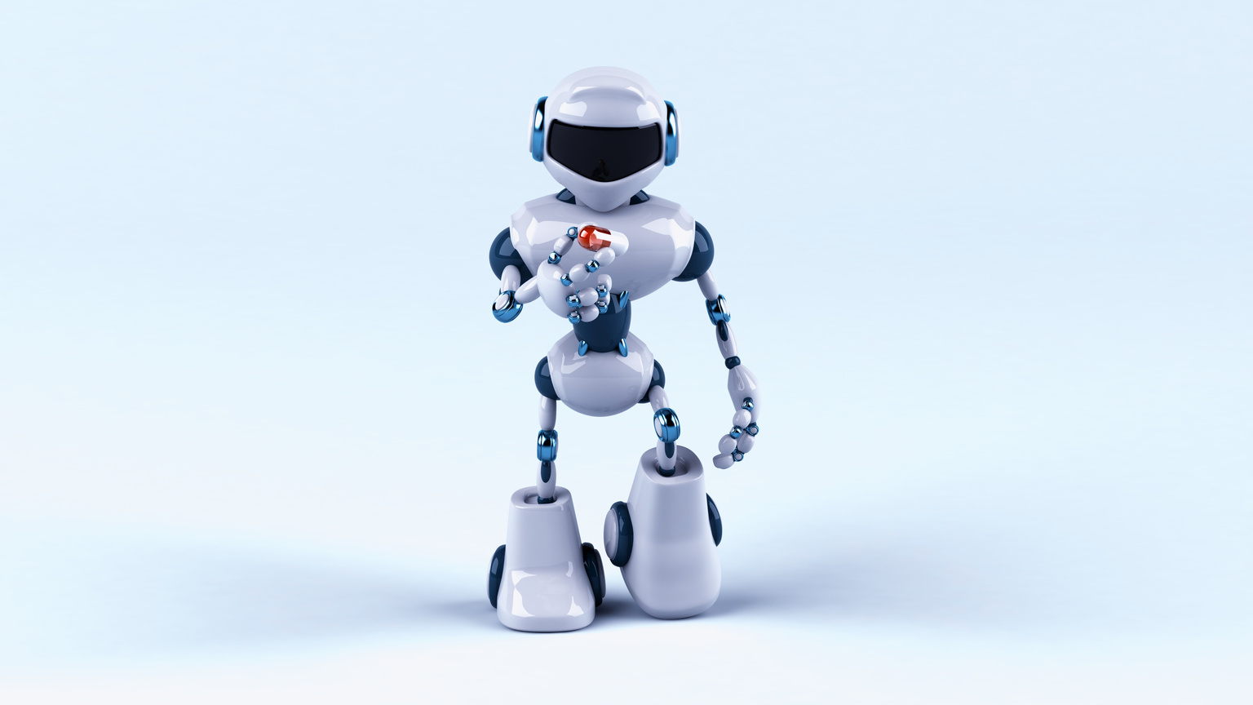
VD25-816821
Feasibility and Viability
Technical
Financial
PROVEN AI MODELS (OCR, TTS, CAPTIONING) INTEGRATED.
LOW-COST DEPLOYMENT WITH CLOUD APIS.
Market
Operational
Risks & Mitigation
39M VISUALLY IMPAIRED IN INDIA, NEED FOR AFFORDABLE TOOLS.
CAN SCALE TO INSTITUTIONS, NGOS.
OFFLINE SUPPORT IN ROADMAP, TRAINING FOR ADOPTION.

Slide 7
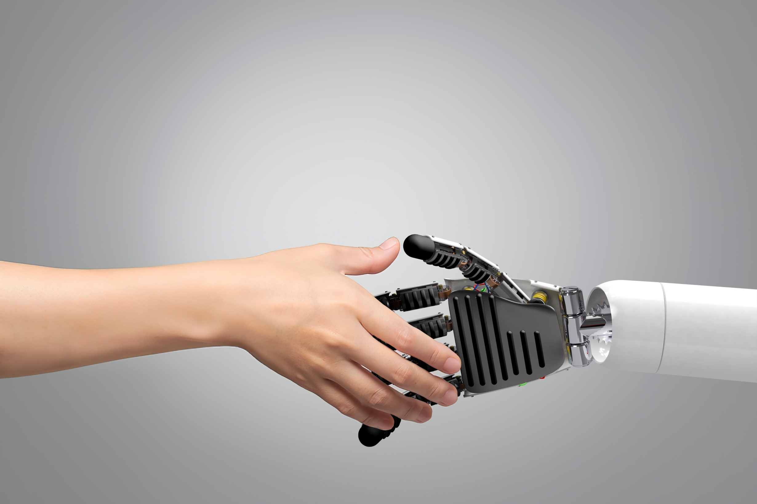
VD25-816821
CONTENT
Impact & Benefits
Social: Independent learning, inclusivity, empowerment.
Economic: Affordable solution, scalable across communities.
Educational: Equal access to digital resources.
Future Scope:
More Indian languages.
Offline mode.
Integration with Braille devices.

Slide 8
VD25-816821
THANK YOU
Accessibility is not just inclusion—it’s innovation. By empowering every learner, we don’t just build tools, we build a future where education has no barriers
-
SENSE VISIION AI

